Slide 1
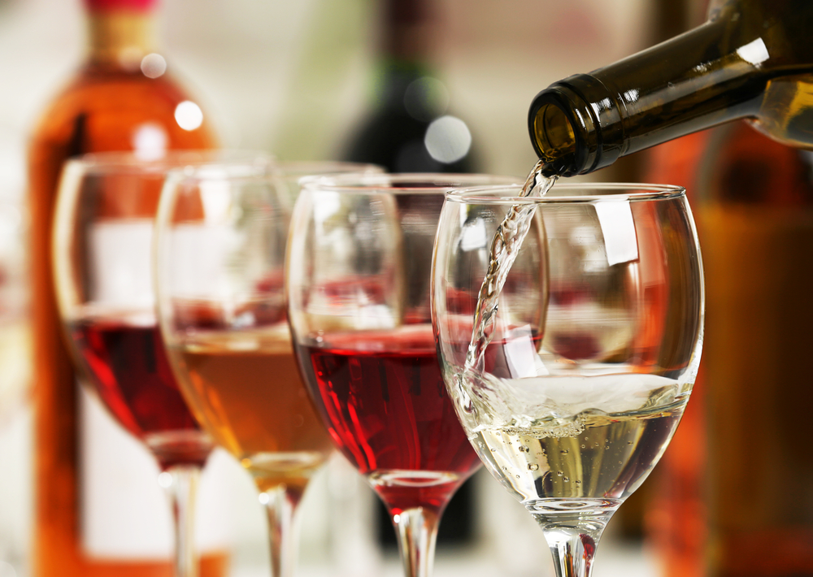
Wine Identifyer
uCI Data Analyst BootCamp
J. Kiernan

Slide 2
Utilizing ML, can a computer guess the type of wine based on review descriptions???

Slide 3
Methodology
Utilized the following:
Kaggle dataset: Wine Reviews
https://www.kaggle.com/zynicide/wine-reviews
Python to slice and clean data
Pandas, numpy, matplotlib
Zepl notebook (code found in .ipynb file)
pyspark.sql functions (length) , pyspark.ml.features (Tokenizer, Stop Words Remover, HashingTF, IDF, String Indexer, Vector Assembler), pyspark ml.classification (NaiveBayes), pyspark.ml.evaluation (Multiclass classification Evaluator) , Aws- S3

Slide 4
About the dataset(s)….
51 mb, with 150,930 reviews
632 unique varieties listed
------------------------
Parsed through data in 3 phases to run through model
Phase 1: utilized “groupby” function to limit the number of varieties to 31 unique varieties
Phase 2: renamed some similar categories which decreased this to 28 unique varieties and limited the dataset only used wines that were rated 90 points or more

Slide 5

How well did it predict? “meh”
best outcome = 60.8%

Slide 6
Phase 1
31 unique values used to classify the data to use for the model predictor
decreased number of reviews to 124, 494
------------------------
training- testing split at 70% / 30% split; predicted accuracy of 59.5%
split changed to 75% / 25% - the model predicted slightly better at 60.8%

Slide 7
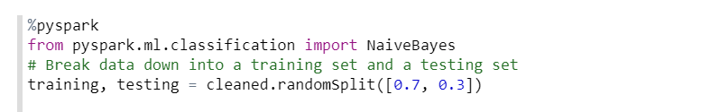
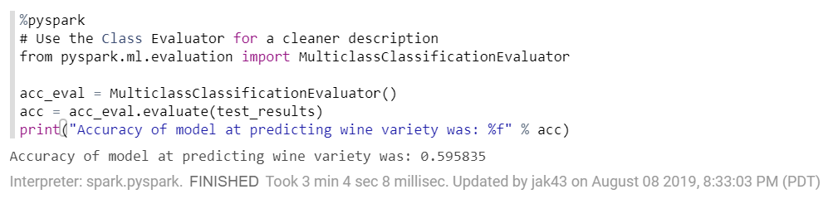
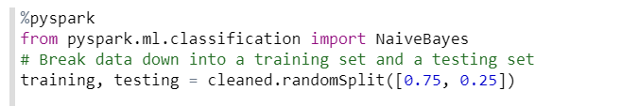
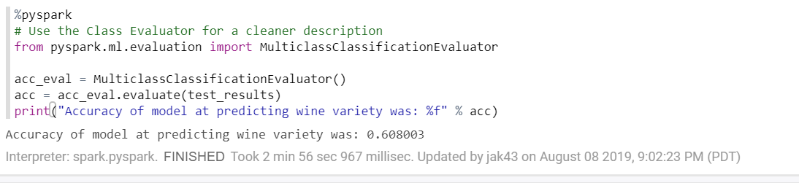
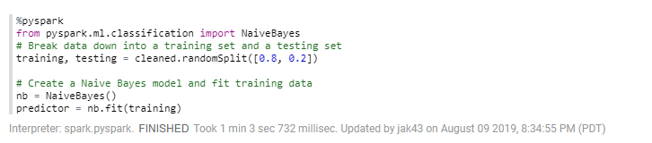
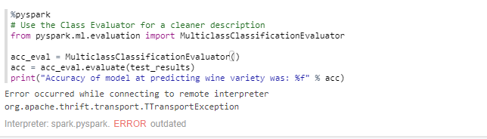

Slide 8
Phase 2
28 unique values used to classify the data to use for the model predictor; grouped together similar wines like, “Red Blend” with “Rhone style Red Blend” and Sparkling Blend with Sparkling, etc.
chose only wines with a point rating of 90 or higher
decreased number of reviews to 28,901
------------------------
training- testing split was done at a 70% / 30% split ; prediction accuracy of 49.5%
split changed to 75% / 25% - the model predicted slightly better at 49.8%
------------------------
Did not perform better with limited set, why???
perhaps it was too small?
because they were all well rated, too many similar words were used across the different varieties?
???

Slide 9
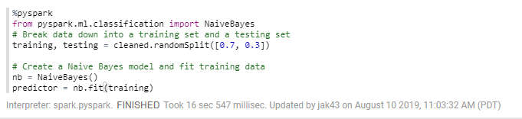
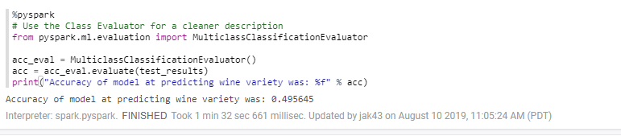
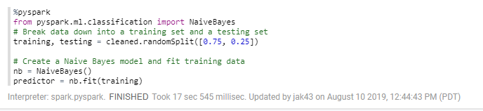
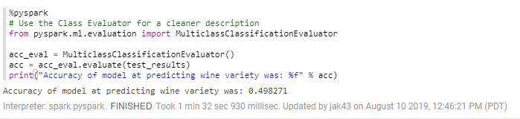

Slide 10

Limitations… and what could have been
This project was limited for me by time and ability. I found ML to be difficult, probably because I didn’t really understand the math that underlay the libraries being utilized. In addition, my understanding of writing code was a definite factor with issues of syntax and such.
The full idea for the project was to create a Virtual Sommelier. I wanted to create a web-page that a user could interface with. Some of the user inputs I was thinking of were: type of wine, price range, and “try something new” based on characteristics of wine the user likes such as “dry”, “sweet”, “fruity”, “oaky”, “light”, “robust”, etc.

